Slide 1
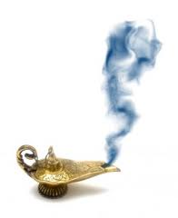
The Genie in the Bottle
Israeli adaptation from UniVie mystery

Slide 2

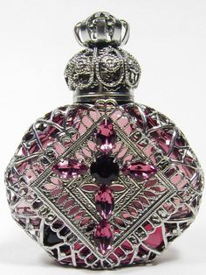
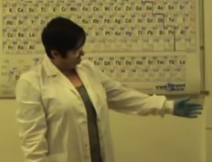
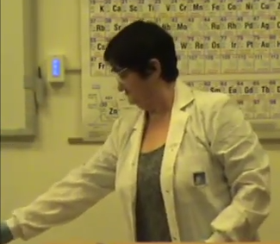
Engage
https://www.youtube.com/watch?v=ZHqzG2cXgUs
https://www.youtube.com/watch?v=mEvD_IEOM6o

Slide 3
Engage
Remember to use scientific words.
Write down your observations, remember to use scientific words.

Slide 4
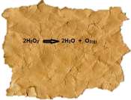
Explore
Near the bottle, I found this note. Could it be a clue?

Slide 5
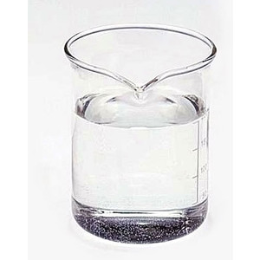
Explore
This is a solution of Hydrogen peroxide.
Should there be another chemical in the scene?
H₂O_{2(aq)}

Slide 6
Explain
What did you learn from the clues?
Connect your new insights to the observations.
Write a clear and organised explanation,
Your explanation should based on the observations and the clues.

Slide 7
... Explain
What is the genie made off?
  Oxygen
  Hydrogen peroxide
  Gaseous water
  Small water droplets
Explain your choice

Slide 8
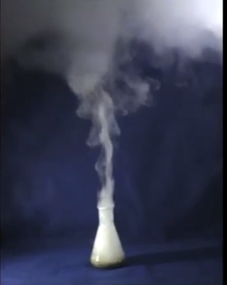
Explain

Slide 9
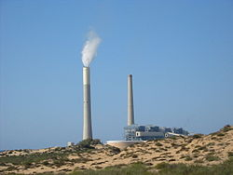
Extend
This picture shows the power plant chimneys.
The fuel combustion products are mainly carbon dioxide and water vapor.
These are emitted through the chimney.

Slide 10
Extend
What is the genie that goes out from the chimney made of?

Slide 11
Evaluate
Take a photo of a phenomenon from your daily life which is explained as the Genie cloud.
  Write a complete and organized explanation of the phenomenon.
Submit all your answers and the photo for evaluation

Slide 12
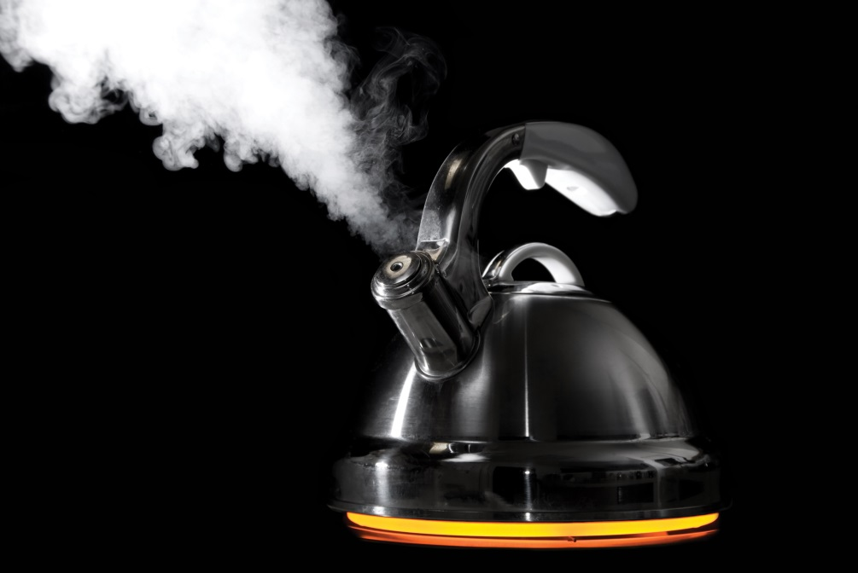
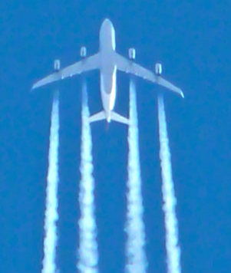
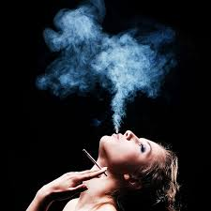
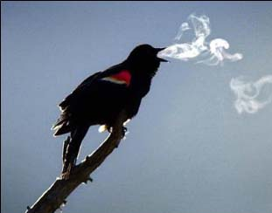


Slide 13
