Slide 1

Functional Food
July 2012
Dr. Anat Solomon
R&D Manager

Slide 2

Functional food

Slide 3
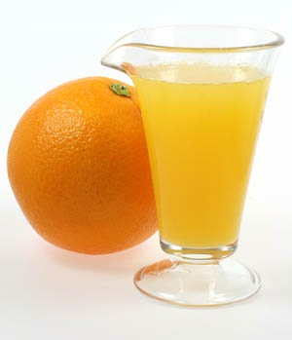
Is this a functional food?
All food is functional in that it provides energy and nutrients necessary for survival

Slide 4
what is a real functional food?
Food that contains effective dosage and effective chemical structure of the active material(s)
“Health supporting food” is a food that have a positive effect on health
Food that promote optimal health and reduce the risk of disease

Slide 5
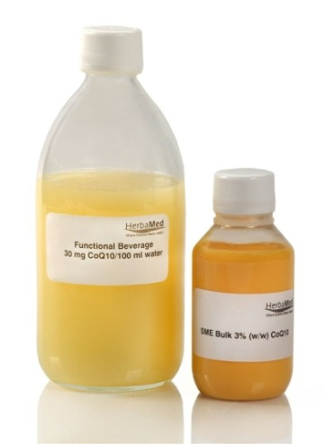
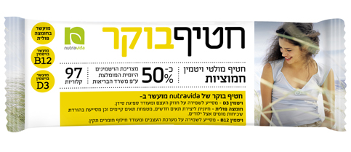
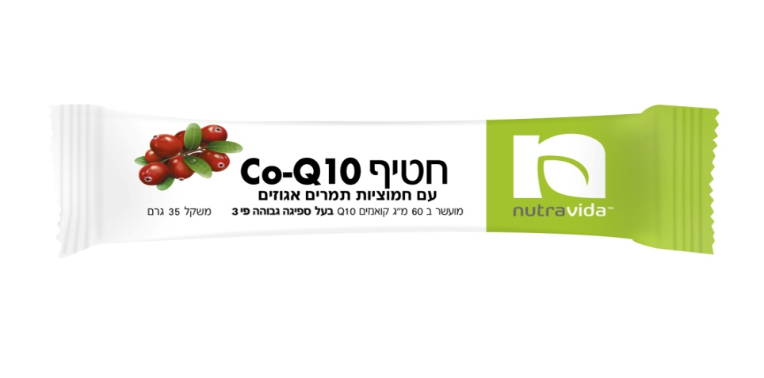
In Herbamed we call it
“Health supporting food”

Slide 6

The story of Coenzyme Q10 snack bar

Slide 7
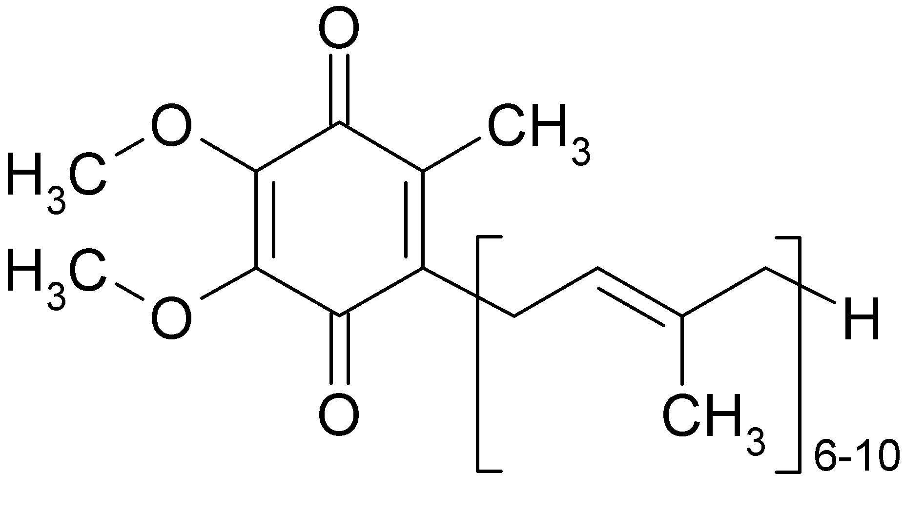
Who is Coenzyme Q10?
Oil soluble, vitamin-like substance
Present in every cell in the body (mitochondria)*
Critical role in energy metabolism
High concentrations in organs with high energy needs
  Heart
  Liver
  Kidneys
  Brain
  Potent antioxidant under lipophilic conditions

Slide 8
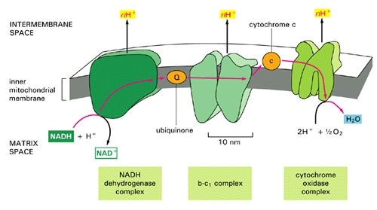
Who is Coenzyme Q10?
Figure 1. The electron transport chain injects protons (H⁺) into the intermembrane space, essentially creating a battery (charge differential across the membrane) that can then complete the process of converting (spent) AMP back to ATP as a renewed energy source. If there is an insufficient supply of coenzyme Q10 (also known as "ubiquinone", the "Q" in the figure), then the electron transport chain will not work as efficiently.

Slide 9
Coenzyme Q10 health benefits
Over 2,700 publications in PubMed
Especially known for role in cardiovascular health
  Energy needs of heart
  Hypertension
  Cholesterol
  Heart muscle
  Brain health/Parkinson
  Recovery after stroke
Physical endurance
Muscles sourness
Oxidative and inflammatory stress

Slide 10
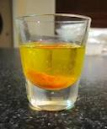
Coenzyme Q10 limitations
Poor bioavailability
  1-5% is absorbed
  Less absorption at higher concentration/not linear absorption
  Reduced self synthesis with age
  Reduced self synthesis with taking drugs/statins

Slide 11
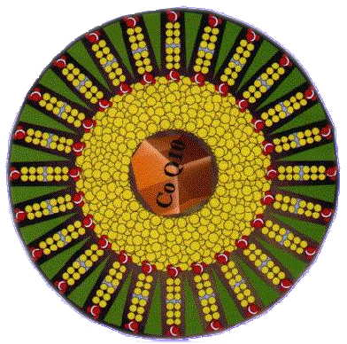
Structure of Ultrasome - CoQ10™
(a hybrid between liposome and emulsion)
Phosphatidylcholine
bi layers
CoQ10 core
Emulsion
Figure 2. Liposomal delivery technology - Designed to solubilize and deliver pharmaceuticals

Slide 12
Bioavailability study: Results
Figure 3. Enhanced Oral Bioavailability of Ultrasome - CoQ10TM Compared to Generic CoQ10 Among Elderly Hospitalized Patients in a Randomized Double-Blind Controlled Study. Study results showed (3x) higher bio-viability of CoQ10 compared to it’s generic counterpart.

Slide 13
Ultrasome CoQ10™ studies
Researchers | Title | Conclusions
Berman, et. al. | Coenzyme Q10 in patients with end stage heart failure awaiting cardiac transplantation: a randomized, placebo-controlled study. | Improvement of symptoms common in patients with heart failure: Walking test Nocturia Fatigue Dyspenea
Gindin, et. al. | The influence of Ultrasome CoQ10™ on cheronic wounds in debilitated elderly inpatient. | Improved healing
Gindin, et. al. | The effect of Ultrasome CoQ10TM treatment on the rehabilitation outcome of elderly patients undergoing surgical repair of hip fracture. | Improved recovery after hip fracture
Gindin, et. al. | Enhanced bioavailability of Ultrasome CoQ10TM compared to genericCoQ10 among elderly hospitalized patients in a randomized double-blind controlled study. | 3x improved bioavailability in elderly patients 10x improved bioavailability in young patients
Sherki, et. al. | Oral administration of Ultrasome CoQ10TM prevents dopaminergic neuronal damage induced by intranigral 6-hydroxydopamine in rats. | Prevention of neural damage

Slide 14

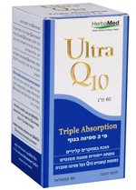
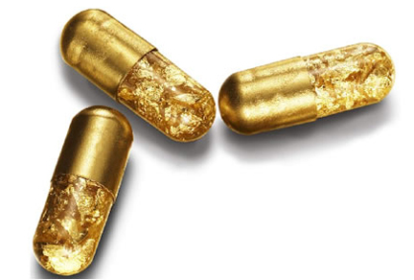
(CoQ10) The story of Coenzyme Q10 snack bar
?

Slide 15

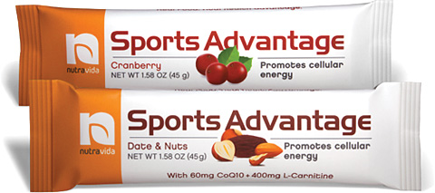
From concept to finished product
Concept : Marketing, exhibitions, researches, nutraceutical best seller, stylish, regulation
Target audience : taste, texture, nutritional facts, valuable ingredients

Slide 16
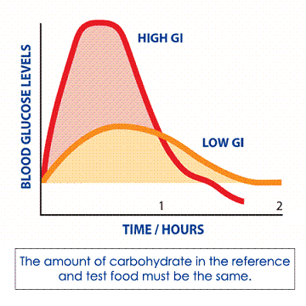
Bar design – nutritional chelanges
Nutritional facts
Mixture of sugars (High and low glycemic indexes)
Low in fat
Low in saturated fat
Low in cholesterol
Low in trans fat
Low in dietary fiber
Proteins and amino acids
Stimulators
Antioxidants

Slide 17
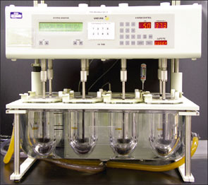
Technological challenges -
Dissolution apparatus
Inert vector

Slide 18
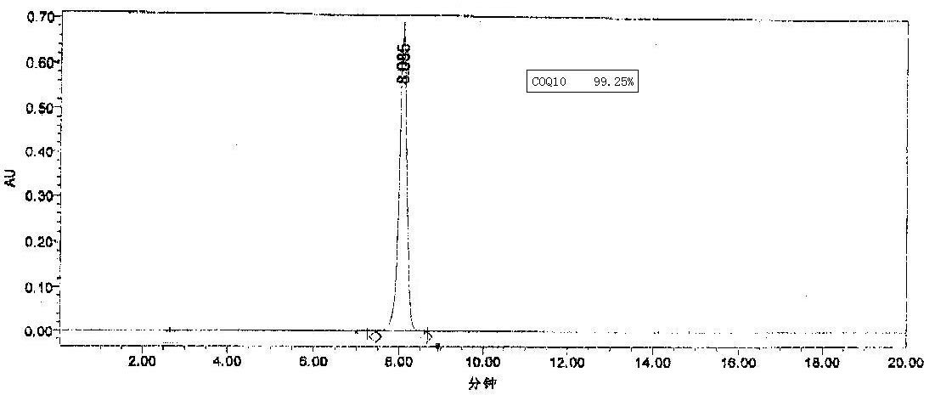
CoQ10 analysis by RF-LC an analytical method
Figure 5. CoQ10 isolation and identification by RF-LC method

Slide 19
Scientific / Clinical challenges

Slide 20
The effect of Coenzyme Q10 nutrition bar treatment on muscle soreness in athletes after physical activity scientific study
Study designed as
A randomized double blind placebo-controlled trail
No. of participates
Thirty Israeli runner's athletes (25 to 56 years, average normal BMI of 21.8 kg/m²)
Study description
Subjects were randomly assigned to receive an oral dose of 400 mg Ultrasome-CoQ10TM (60 mg of CoQ10) once daily as nutrition or placebo bar form for two periods of one week separated by a one week wash-out period.

Slide 21
Results of the scientific study
Figure6. The influence of Ultrasome-CoQ10TM supplementation on muscle soreness among athletes. Oral administration of 400 mg of Ultrasome-CoQ10TM (60 mg of CoQ10) as nutrition bar form before physical activity for 1 week significantly reduced muscle soreness and fatigue at the intervention group (p<0.05). At the control group the results were not statistically significant.
Dr. Anna Aronis et al, 2012. The Hebrew university in Jerusalem, Department of nutrition and food technology

Slide 22

Health Promoting food summary- Herbamed vision
Focusing on health solution by
Enhancing the bioavailability of active materials
Proven efficacy in clinical trials and scientific studies
Using therapeutic dosage levels
Synergy between active ingredients
Improvement of
Taste
Texture
Nutritional values
Valuable ingredients
Improvement of facilities, processes and analytical methods
Patents and scientific studies

Slide 23




Slide 24

Contact us
Dr. Anat Solomon
R&D Manager
Herbamed Ltd.
7 Opphenhimer st.
Rheovot. 76701
Israel
E-mail:anats@herbamed.co.il

